Slide 1




TASK 2
Introduction
Stakeholders
Techniques
Results
specifications
Requirement
Gathering
Group 8

Slide 2




Introduction
Stakeholders
Techniques
Results
specifications
Requirement
Gathering
In today’s fast- growing world, road safety and awareness are of paramount importance. With the increasing number of vehicles on the road, it has become essential to have real-time information about the road state and road signs to ensure a safe and efficient journey.
Next

Slide 3

Introduction
Stakeholders
Techniques
Results
specifications
Outline
1
Stakeholder Identification
2
Techniques
3
Results
4
Collected Specs
5
User Reluctance Assesement
6
Conclusion

Slide 4



Stakeholders
Introduction
Techniques
Results
specifications
Stakeholders Identification
Stakeholders are individuals or groups who are impacted by or can influence the outcome of the project.
They bring diverse perspectives and hold a vested interest in the requirement elicitation of the project and its outcome, helping in crucial decision-making, as their needs and concerns can help identify risks and opportunities.
Internal
External
Core Developers
Commited Users

Slide 5



Stakeholders
Introduction
Techniques
Results
specifications
Internal
Stakeholders
An internal stakeholder is a person, group, or company that is directly involved in the project.They help contribute to the evolvement of the project.
Project Team
Data provider
RIB
Road infrastructure body (RIB)

Slide 6

Stakeholders
Introduction
Techniques
Results
specifications
External
Stakeholders
External stakeholders are individuals not directly concerned in the project development process but who will be impacted by the activities, decisions and outcomes.
End Users
Potential Investors

Slide 7

Techniques
Introduction
Stakeholders
Results
specifications
Requirement Gathering Techniques
1
Surveys
3
Reverse Engineering
This is a data collection method used to gather information from a sample of people or entities, used to gather feedback.
This involves evaluating and understanding strengths, and weaknesses of existing systems providing similar solutions. After these study, we came out with two main existing solutions
2
Interviews
4
BrainStorming
This is another method of gathering requirements which involves questioning concerned individuals to get more information about their needs regarding the system.
This involves gathering together to exchange ideas and insights between project team member.

Slide 8




Results
Introduction
Stakeholders
Techniques
specifications
Results
Results Observation
After gathering data from diverse stakeholders, we had the role to analyse the data. This was done to have a clear understanding of our system and produce a quality product.
Tools for Observation
google sheets
Power BI
Excel

Slide 9

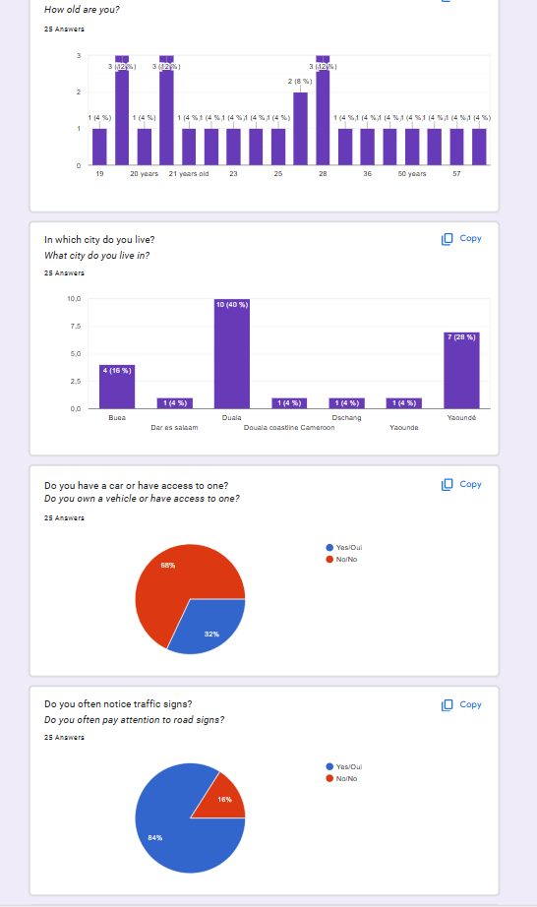
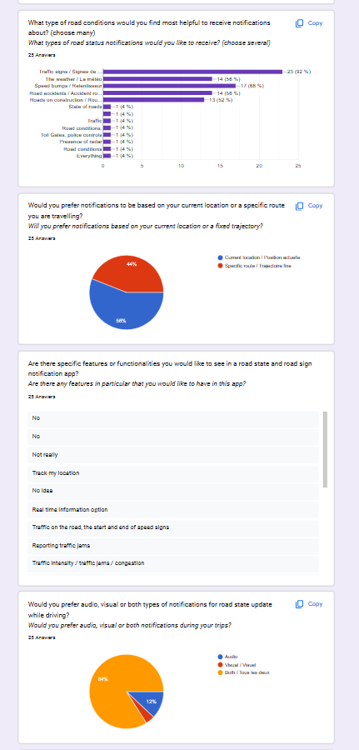

Results
Introduction
Stakeholders
Techniques
specifications
Google Sheet Observation
Google sheet was created to ease communication with stakeholders and provide fast response. It helped us get variety of data from the questions since users had different perspectives
Previous
Next

Slide 10
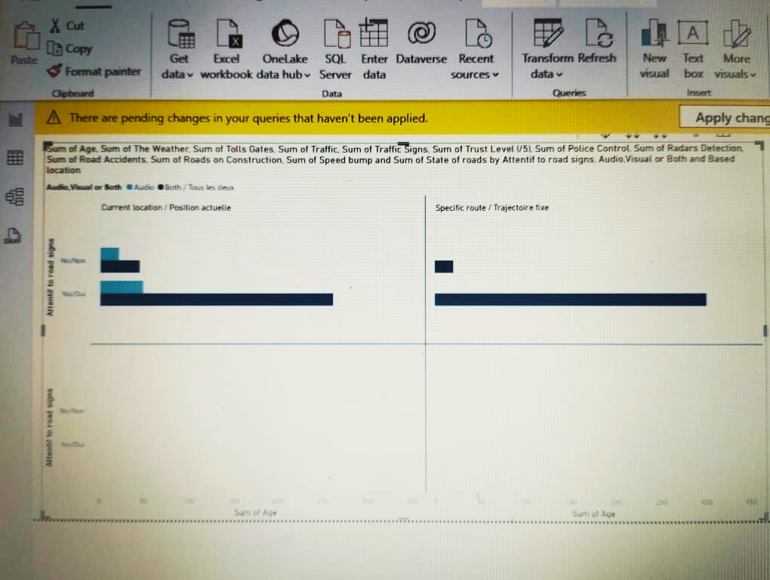


Results
Introduction
Stakeholders
Techniques
Documentation
Refining the Data using Power BI
Power BI is a tool used to refine data ie data visualisation, data intergration and data analysis from diverse sources.
This helped use to visualise clearly what requirements are important in our system from the stakeholders.

Slide 11
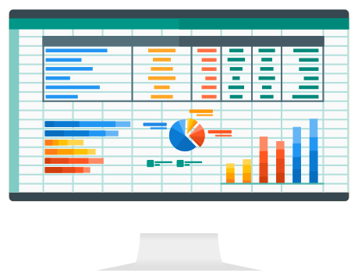
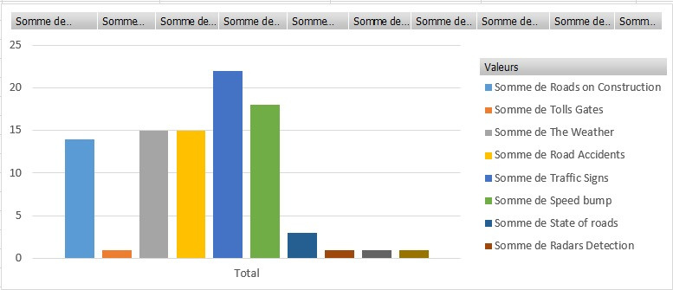
Results
Introduction
Stakeholders
Techniques
specifications
Visualising Prefered
Functionalities with Excel
Excel is a versatile tool for data gathering, organization, and analysis through spreadsheets, offering easy manipulation and visualization of data.
Excel helps us figure out which features are most important to the stakeholders in a clear, organized way.

Slide 12
Specification
Introduction
Stakeholders
Techniques
Results
Collected Specs
From Surveys
Road Sign Information
Voice Support
Weather Related Hazard
Tracking User’s Location
Real Time Traffic Updates
Multilanguage Support
Notification Preferences
No Ads Presence
Route Redirection
Offline Mode

Slide 13

Specification
Introduction
Stakeholders
Techniques
Results
Collected Specs
From Existing Solutions
Toll Gate Positions
Trajectory Plannification
Real Time Speed Counter
Road State Update Permission
Location Sharing
Frequently Accessed Locations

Slide 14

Specification
Introduction
Stakeholders
Techniques
Results
Collected Specs
From Brainstorming
User Login and Logout
Dashboard Monitoring
Collected Specs
From Interviews
Police Control Position
Radar Position

Slide 15


Specification
Introduction
Stakeholders
Techniques
Results
User Reluctance Assessment

Slide 16






GROUP 8 CORE TEAM
Thank You
Atsafac Agafina
Nguepi Paterson
Negue Kwaham
Stephane Merci
Kamdem Gilles

